Slide 1
New Hire Quick Reference Guide TCS Human Resources North America 2016

Slide 2
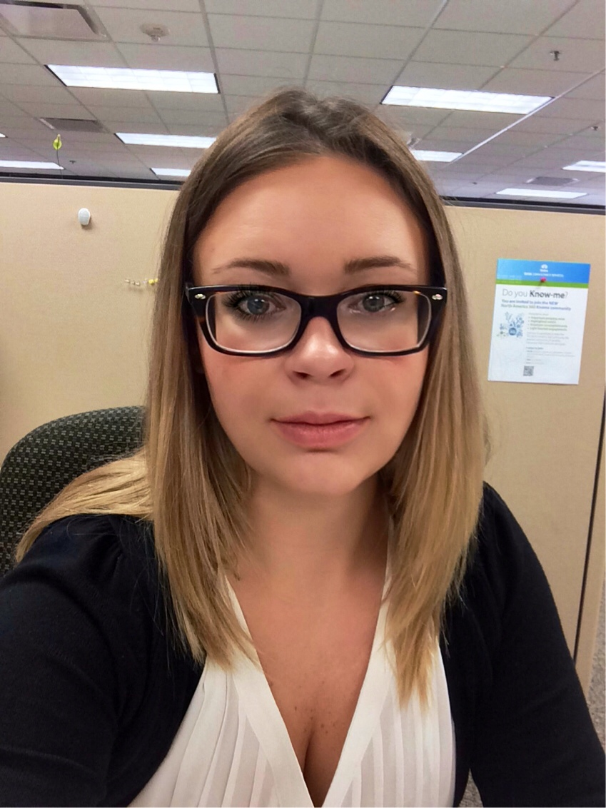
Introductions
Paulina Bettini
Talent Engagement Partner
NJ – Eastern Region
Human Resources
Office: Edison, NJ
Work Phone Number: 732 491-0140 Cell Number: 425 516-9851 Mail to: paulina.sperczak@tcs.com

Slide 3
HR Support – Eastern Region
Isaac Arun (123807)
Regional HR Manager
Eastern Region
Antony Praveen (241057)
Talent Engagement Partner
NY Region
Naveen Shetty (208422)
Talent Engagement Partner
MA, CT, NH, RI, VT, ME Regions
Paulina Bettini (1000071)
Talent Engagement Partner
NJ Region & Bank of America (Eastern)
PonPandian Ap (516367)
Talent Engagement Partner
NJ Region
Luis Rodriguez (1122995)
Talent Engagement Partner
PA Region
Sujata Majumdar (143987)
Talent Engagement Partner
MMU, GCP, Digitate and DSSG Group
Donna Gomez (1069823)
Talent Engagement Partner
DC, DE, VA, WV, MD Regions
Kala M (189509)
Talent Engagement Partner
GE & FS Ops

Slide 4
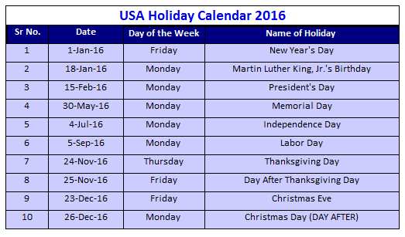
TCS Company Holidays
Please note, all associates allocated to a project must abide by the Client/Project Holiday Calendar.

Slide 5
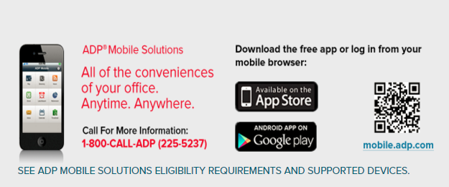
ADP I-Pay
Registering for your iPay Statements and W2 Form
Go to https://ipay.adp.com
Click on the link ‘Register now’.
Enter registration pass code
To confirm registration code, please contact HR Helpline at (866) 502-2494
Logging in to your ipaystatements
Go to https://ipay.adp.com
Click on Login button
Enter your User ID (Example ASmith@TLS) and your current Password
Any questions or problems contact HR Helpline at (866) 502-2494

Slide 6
2016 Payroll Calendar
 |  | Pay Period
Payroll # | Week | From | To | Pay Date
1 | 2 | 26-Dec-15 | 8-Jan-16 | 14-Jan-16
2 | 4 | 9-Jan-16 | 22-Jan-16 | 28-Jan-16
3 | 6 | 23-Jan-16 | 5-Feb-16 | 11-Feb-16
4 | 8 | 6-Feb-16 | 19-Feb-16 | 25-Feb-16
5 | 10 | 20-Feb-16 | 4-Mar-16 | 10-Mar-16
6 | 12 | 5-Mar-16 | 18-Mar-16 | 24-Mar-16
7 | 14 | 19-Mar-16 | 1-Apr-16 | 7-Apr-16
8 | 16 | 2-Apr-16 | 15-Apr-16 | 21-Apr-16
9 | 18 | 16-Apr-16 | 29-Apr-16 | 5-May-16
10 | 20 | 30-Apr-16 | 13-May-16 | 19-May-16
11 | 22 | 14-May-16 | 27-May-16 | 2-Jun-16
12 | 24 | 28-May-16 | 10-Jun-16 | 16-Jun-16
13 | 26 | 11-Jun-16 | 24-Jun-16 | 30-Jun-16
14 | 28 | 25-Jun-16 | 8-Jul-16 | 14-Jul-16
15 | 30 | 9-Jul-16 | 22-Jul-16 | 28-Jul-16
16 | 32 | 23-Jul-16 | 5-Aug-16 | 11-Aug-16
17 | 34 | 6-Aug-16 | 19-Aug-16 | 25-Aug-16
18 | 36 | 20-Aug-16 | 2-Sep-16 | 8-Sep-16
19 | 38 | 3-Sep-16 | 16-Sep-16 | 22-Sep-16
20 | 40 | 17-Sep-16 | 30-Sep-16 | 6-Oct-16
21 | 42 | 1-Oct-16 | 14-Oct-16 | 20-Oct-16
22 | 44 | 15-Oct-16 | 28-Oct-16 | 3-Nov-16
23 | 46 | 29-Oct-16 | 11-Nov-16 | 17-Nov-16
24 | 48 | 12-Nov-16 | 25-Nov-16 | 1-Dec-16
25 | 50 | 26-Nov-16 | 9-Dec-16 | 15-Dec-16
26 | 52 | 10-Dec-16 | 23-Dec-16 | 29-Dec-16

Slide 7
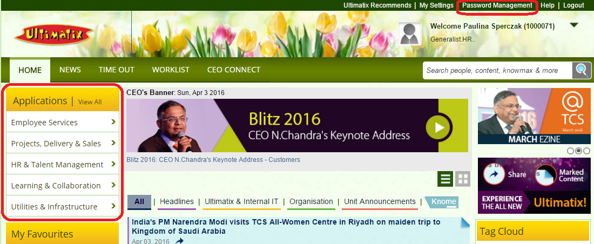
Ultimatix
Ultimatix is TCS’ internal portal
You will receive your TCS Employee Number up to 72 hours after your initial start date.
Your Employee Number will be sent in an email to the email address that you provided to your recruiter.
Once you receive your Employee Number our support team in India will give you access to Ultimatix.
https://www.ultimatix.net
Access rights will take approximately 6 hours

Slide 8
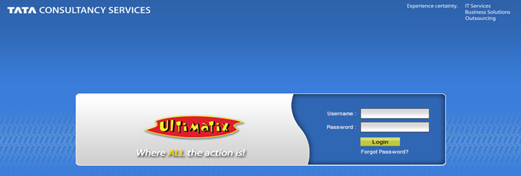
Ultimatix: First Time Log In
When logging in for the first time:
User Name is your Employee ID #
Default Password is ChangePwd@DDMMYYYY (Date of Birth in DDMMYYYY format)
You will be asked to change your password after initial log in
New password Requirements:
1 Capital Letter
1 Number
1 Special Character
Minimum of 8 Characters
Due to security regulations, you will be required to change your password every 30 days.

Slide 9
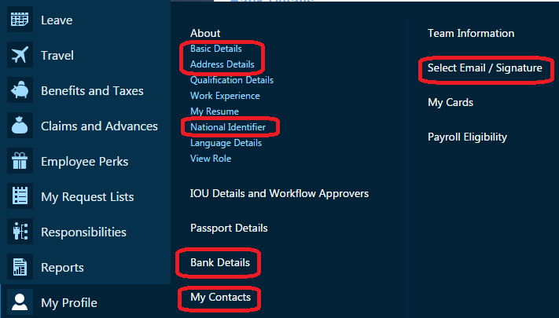
GESS – My Profile
In order to be set up for TCS benefits and complete your onboarding you will have to follow the menu path below and complete the following Profile details.
Ultimatix -> Employee Services -> Global ESS->My Profile
Basic Details ->Legal Name, Marital Status, Nationality, Gender, and Personal Contact Details
Address Details -> Home Address
Social Security Number
My Contacts ->Emergency Contacts/Dependent Details
Bank Details -> Payroll and Claim Reimbursement (see slide 10)
TCS Email Selection/Signature (see slide 16)

Slide 10
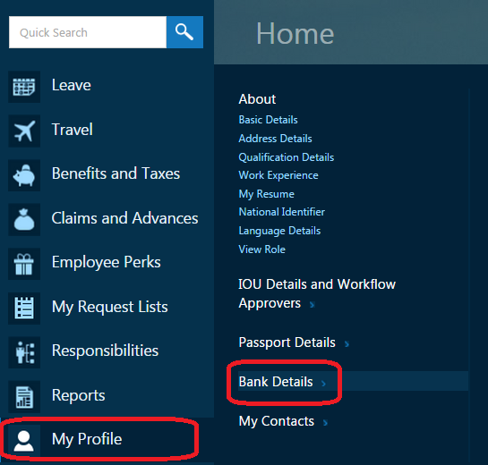
GESS - Bank Details for Payroll Direct Deposits
To set up direct deposit follow the path below:
Ultimatix Homepage >>Employee Services>>Global ESS >> My Profile >> Bank Details

Slide 11

GESS - Bank Details for Payroll Direct Deposits
Click on CREATE BASE button to add new bank details.
You will need to provide the following details:
Account Type -> Select Checking or Saving
Account Nature -> Select United States Local Hires Bank
Account Number
Bank Name
Routing Number
Your First Name
Your Last Name
Account Category US Local *-> Select “Primary”

Slide 12
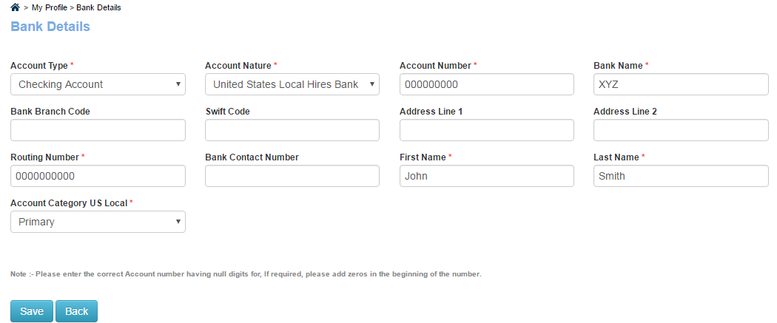
GESS - Bank Details for Payroll Direct Deposits

Slide 13

GESS - Bank Details for Claim Reimbursements
Click on CREATE OVERSEAS button to add new bank details.
You will need to provide the following details:
Account Type -> Select Checking or Saving
Account Nature -> Select United States Local Hires Bank
Account Number
Bank Name
Routing Number
Your First Name
Your Last Name
Mark as SALARY ACCOUNT
Please Note: You MUST enter your bank details here for your expense claims to be directly deposited. This is for claims only and not direct deposit of your paycheck

Slide 14
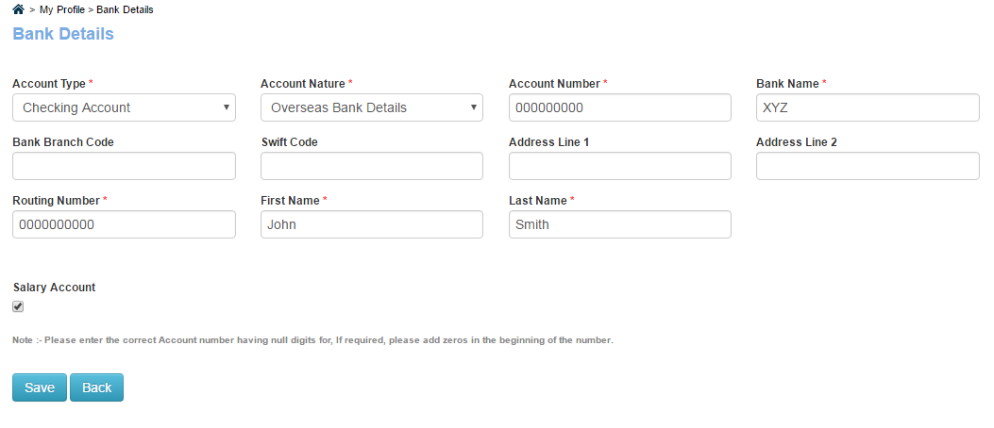
GESS - Bank Details for Claim Reimbursements

Slide 15
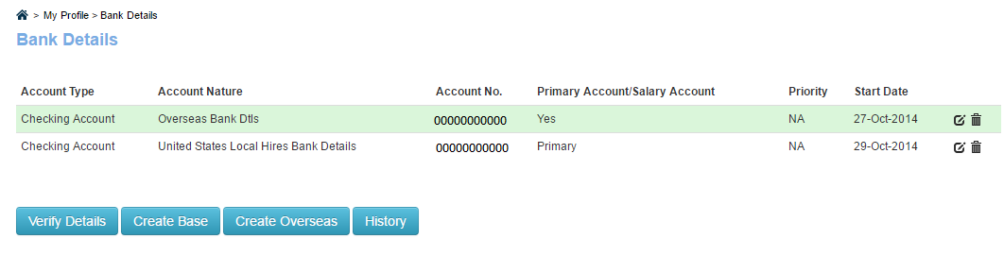
GESS - Bank Details
Upon clicking SUBMIT, the data entered will appear as a row as shown below.
These details can be edited/end-dated.
Secondary account for payroll direct deposit can be added.
Please note it takes 1-2 pay cycles to validate your account information.
*First paycheck will be live and mailed to home address in Global ESS Profile

Slide 16
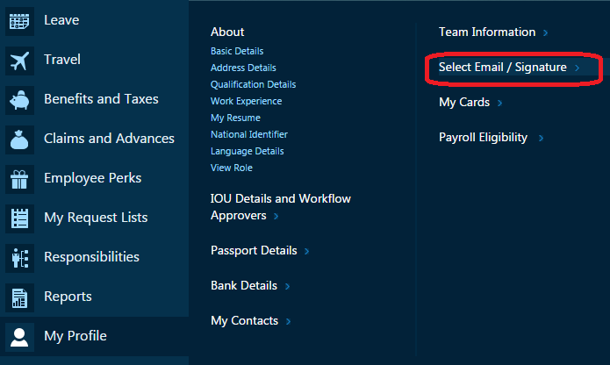
GESS - TCS Email ID Creation
To select an TCS email address:
Ultimatix Homepage ->Employee Services->Global ESS -> My Profile -> Email selection
Select your email address and update your signature
Please note that all email communications will be sent to your TCS email, you are expected to log in and check your TCS email on a regular basis.

Slide 17
TCS Webmail/Lotus Notes
After about 3 hours you can gain access to Webmail to access email server remotely
Login for Webmail: https://webmail.tcs.com
Your user name is the entire e-mail ID that you have selected in Global ESS
Your default webmail password is ChangePwd@DDMMYYYY (Date of Birth in DDMMYYYY format)
If you were provided a TCS Laptop you can request Lotus Notes via Ultimatix Helpdesk:
Please raise a ticket with the Ultimatix Helpdesk.
Call the Ultimatix Helpdesk at 1-877-TCS-INDY (1-877-827-4639) or 732 590 2727 and give the representative your ticket number.
The representative will configure Lotus Notes for you remotely while you are on the phone.
If you received a TCS Laptop please do not install updated versions of Internet Explorer (IE 9 or 10).
The Password Management section allows you to change your passwords at any time.
You can reset your password yourself by clicking on “Forgot my Password” and using your “Secret Question”.
To set up your “Secret Question”, click on the Password Management tab on the upper right hand corner of the Ultimatix Homepage. Once the page has loaded please click on Secret Question. Set up your secret question and answer.

Slide 18
Ultimatix Helpdesk
To create a ticket with the Ultimatix Helpdesk:
Ultimatix ->Employee Services->Helpdesk->TCS Global Helpdesk->Select the Application Link>> Click on Services->Ticketing Tool
Once you complete the ticket and receive a ticket number you can contact the Global Helpdesk at: 1-877-827-4639 or 732 590 2727
If you lock yourself out of Ultimatix & you do not have a TCS email ID you must have your manager or someone from HR email the Ultimatix Helpdesk (ultimatix.helpdesk@tcs.com) to reset your password.
The email should contain your:
Employee ID
Date of Joining
Date of Birth

Slide 19
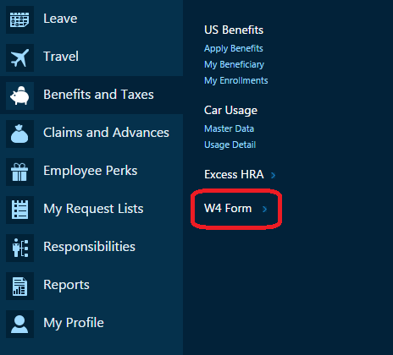
GESS – W4 Form
Ultimatix ->Global ESS–> Benefits and Taxes->W4 Form
Upon clicking on W4 Form, the screen called “Personal Allowance worksheet” will appear.
Enter the numerical values as indicated in the instructions.
Click on CONTINUE after entering all values or RESET to erase all.
The W4 Form will appear after clicking CONTINUE. It will contain your SSN and Residence Address.
Click on your correct Marital status in Item 3.
Enter the amount that needs to be withheld in Item 6.
Write EXEMPT in Item 7 if you are exempt from all tax liabilities.
Click SUBMIT.

Slide 20
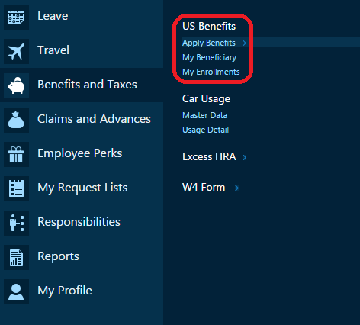
Global ESS – Benefits Election
Once all information has been added\updated in your Global ESS Profile you must wait 24 hours before selecting your TCS Health Insurance Benefits
Please note, you need to add dependents first in My Profile->Contacts and tag as “Dependent” to add them to TCS health insurance plans.
Ultimatix->Employee Services->Global ESS->Benefits and Taxes->US Benefits
Click on “Apply Benefits”

Slide 21
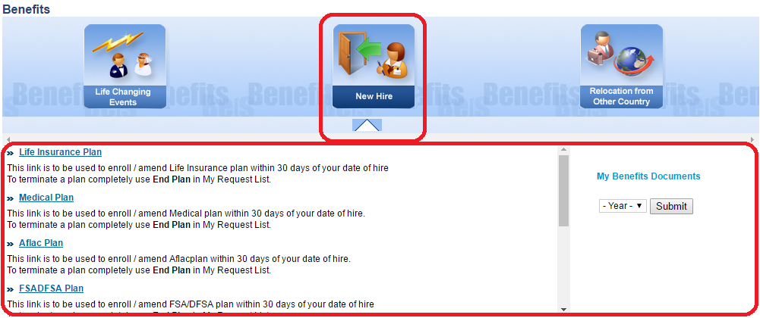
GESS – Benefits Selection
Select “New Hire” as the event type, select the applicable plan and click on “Submit”
You can view your Benefit Enrollments through Global ESS > Benefits and Taxes > US Benefits > My Enrollments or Global ESS > My Request Lists > Benefits and Taxes > Benefits Requests
To view complete plan and procedure documents, you can log into Ultimatix > Knowledge Management > Knowmax > MY HR > North Americas > US > Local Associates > My Benefits > Insurance

Slide 22
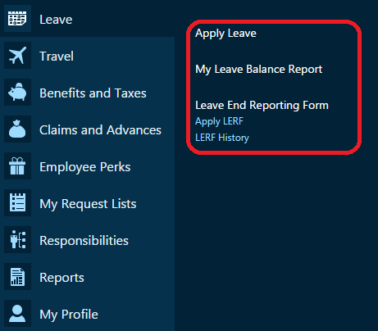
GESS – Leave Application
Ultimatix->Employee Services->Global ESS->Leave
Apply Leave Request
Check your Leave Balance Report
Submit Leave Ending Reporting Form (LERF)
Please note LERF is required when returning from Leave without Pay
Any questions or problems contact HR Helpline at (866) 502-2494

Slide 23
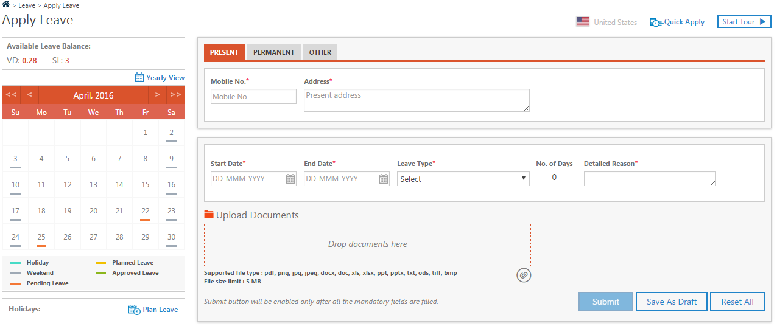
GESS– Leave Application
Confirm personal contact details
Select Leave Dates and Leave Type (Sick, Vacation, Jury Duty, Bereavement, LWP, etc.)
Provide detailed reason for leave request
Upload applicable documents, if required (i.e. Jury duty notice, Doctors note, FMLA paperwork, etc.)
Click on “Start Tour” for guidance

Slide 24
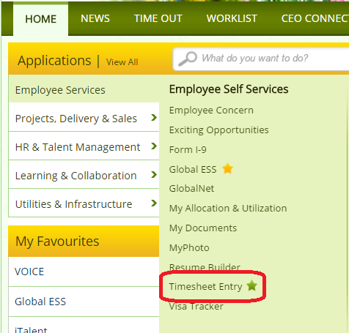
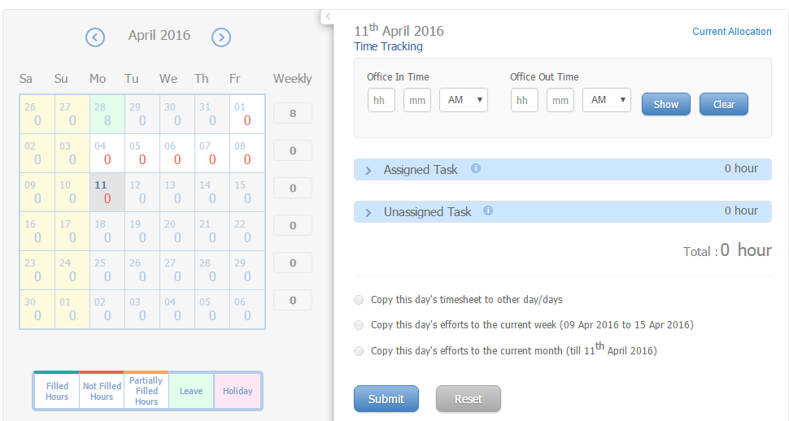
IPMS – Timesheet Entry
Ultimatix->Employee Services->Timesheet Entry
Once the Timesheet loads, click on the applicable date from the calendar and follow instructions on the next slide
Any questions or problems contact HR Helpline at (866) 502-2494

Slide 25
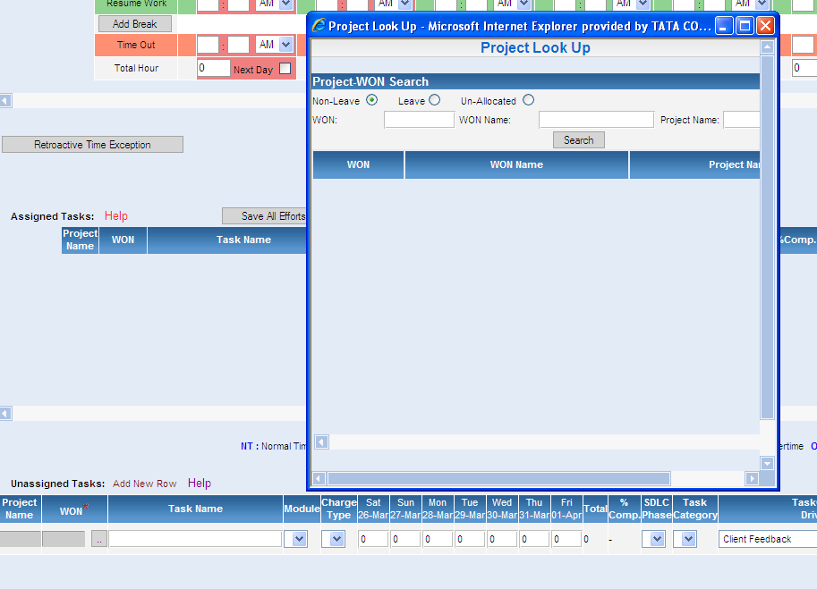
IPMS - Timesheet Entry
2. Type in S/WON
3. Click Search Button
1. Click on dotted box to enter S/WON in pop-up box

Slide 26
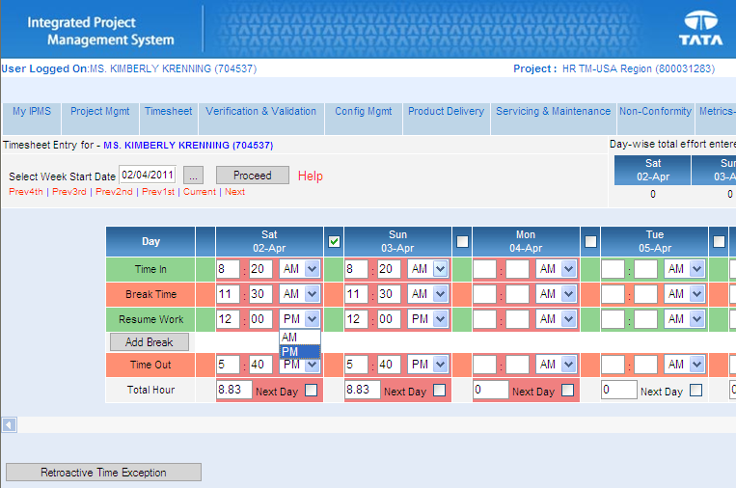
IPMS - Timesheet Entry
4. You can check the below box to duplicate the previous day’s schedule
1. Enter time in minutes, e.g. 8:20am or 5:40 pm
2. Select AM or PM
3. Total Hours are digitally calculated daily. It is numerically calculated as a portion of a full hour

Slide 27
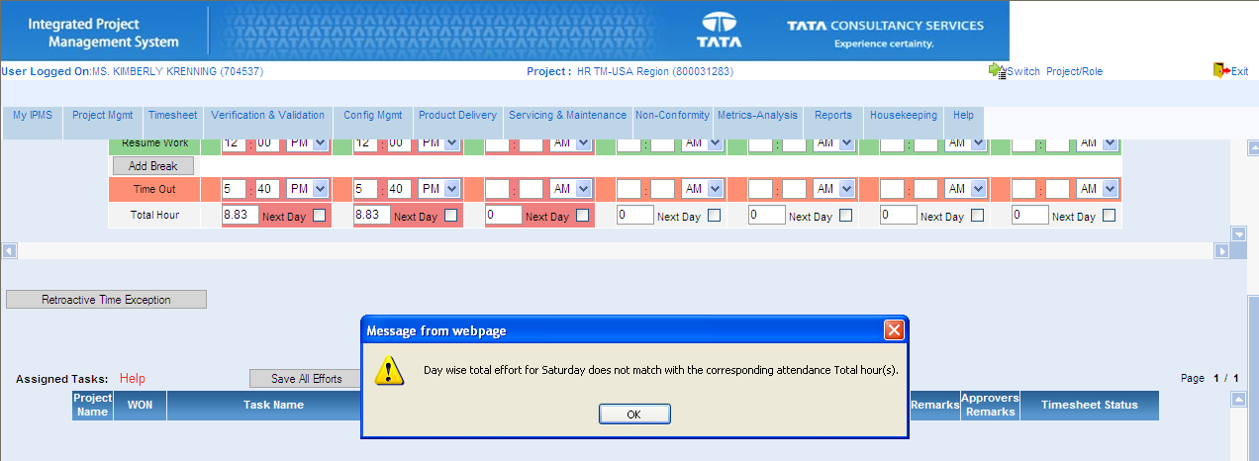
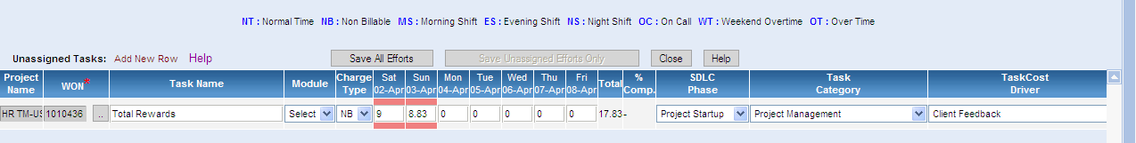
IPMS - Timesheet Entry
2. If the daily numbers do not match –as shown in this example-you will get a pop up box with explanation
2. Enter time at the bottom of the page and enter exactly as it is digitally calculated

Slide 28
GESS – Business Travel
Your position at TCS may require some travel. TCS has a convenient way of booking all business air and train travel using Global ESS.
All other travel arrangements must be booked outside of Ultimatix and submitted for reimbursement, i.e. hotel, car rental, local conveyance, etc.
Ultimatix->Employee Services->GESS->Travel->Domestic Travel->Business Travel
You will receive notice via email that your request was submitted for approval and when it has been approved.
You will receive your travel itinerary via email
Allow 3 to 5 Business days for your travel request to process
For last minute travel request approvals or issues please contact: usa.travel@tcs.com and/or usa.travelsupport@tcs.com
Any questions or problems contact HR Helpline at (866) 502-2494

Slide 29
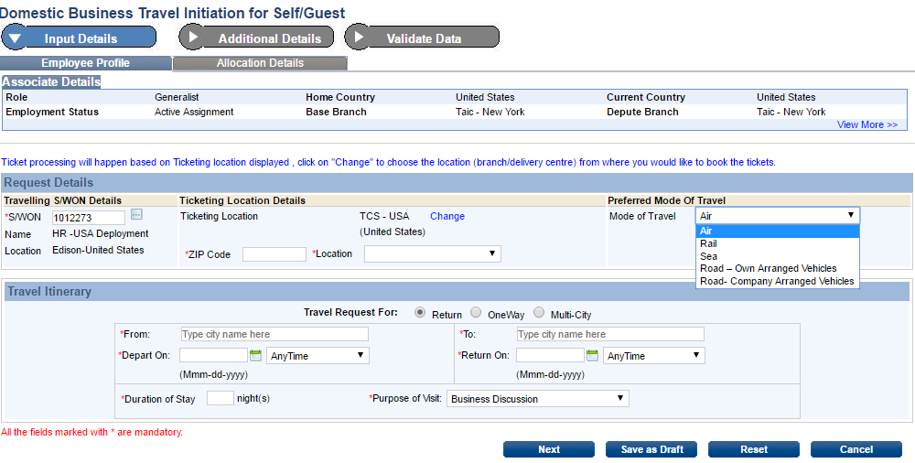
GESS – Business Travel
Travelling S/WON should be your current project S/WON in most cases

Slide 30
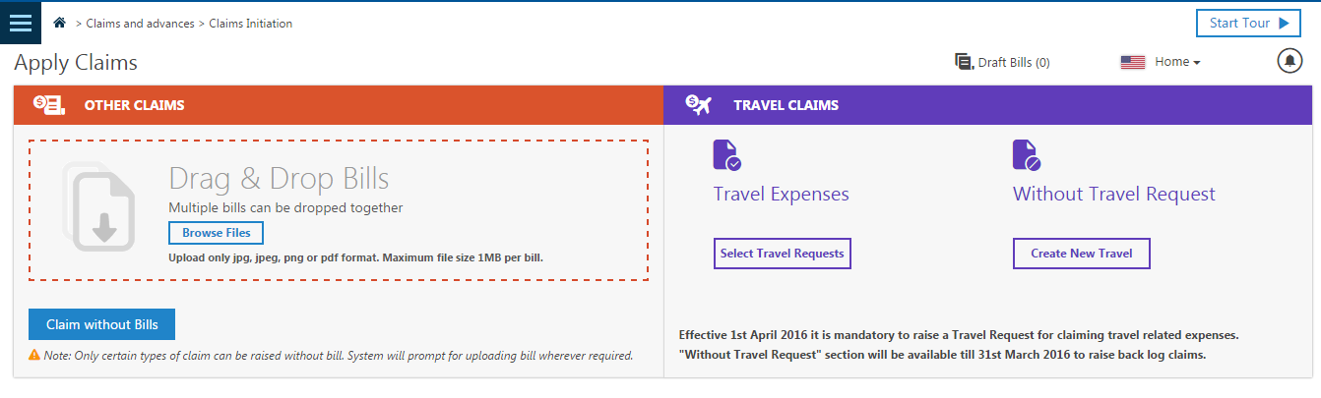
GESS – Claim Reimbursement
The path to raise claim requests is as follows:
Ultimatix → Employee Services -> Global ESS → Claims and Advances → Apply Claim
Any questions or problems contact HR Helpline at (866) 502-2494

Slide 31
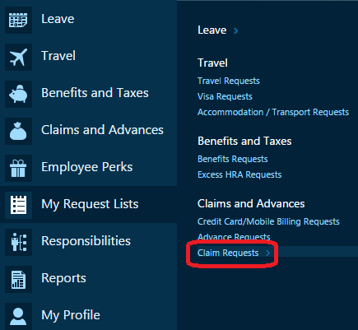
GESS – Claim Reimbursement
If there is an existing/corresponding travel request , please click on ‘Travel Request’ and fill in the business travel details
If there is no existing/corresponding travel request, please click on ‘Without Travel Request’ and fill in business travel details
Non-business travel claims should be submitted under “Other”
You can check the status of your claim and worklow details:
Global ESS-> My Request List->Claims and Advances-> Claim Requests

